Slide 1
04
Quality testing using SARS-CoV-2 Antigen RDTs

Slide 2
Disclaimer
WHO Health Security Learning Platform – Training Materials
These WHO Training Materials are © World Health Organization (WHO) 2020. All rights reserved.
Your use of these materials is subject to the “WHO Health Security Learning Platform, Training Materials – Terms of Use”, which you accepted when downloading them and which are available on the Health Security Learning Platform at: https://extranet.who.int/hslp.
Should you adapt, modify, translate, or in any other way revise the contents of these materials, you shall not imply that WHO is in any way affiliated with such modifications and shall not use the WHO name or emblem in such modified materials.
Furthermore, please inform WHO of any modifications of these materials that you use publicly, for record-keeping purposes and continued development, by emailing ihrhrt@who.int.

Slide 3
Learning objectives
At the end of this module, you should be able to:
describe what is quality testing and why is it important
explain the types of inaccurate results and their consequences
list common errors in the pre-testing, testing and post-testing phases and how to avoid them.

Slide 4
What is a quality test and why is it important?
A quality test is accurate and reliable, with results reported in a timely manner.
Quality-assured SARS-CoV-2 Antigen RDT testing is critical for the correct management of patients.
As health workers performing SARS-CoV-2 Antigen RDT testing, you are critical to scaling up COVID-19 testing in your country and saving lives.
It is your responsibility to ensure the quality of the tests you perform by avoiding errors in testing.

Slide 5
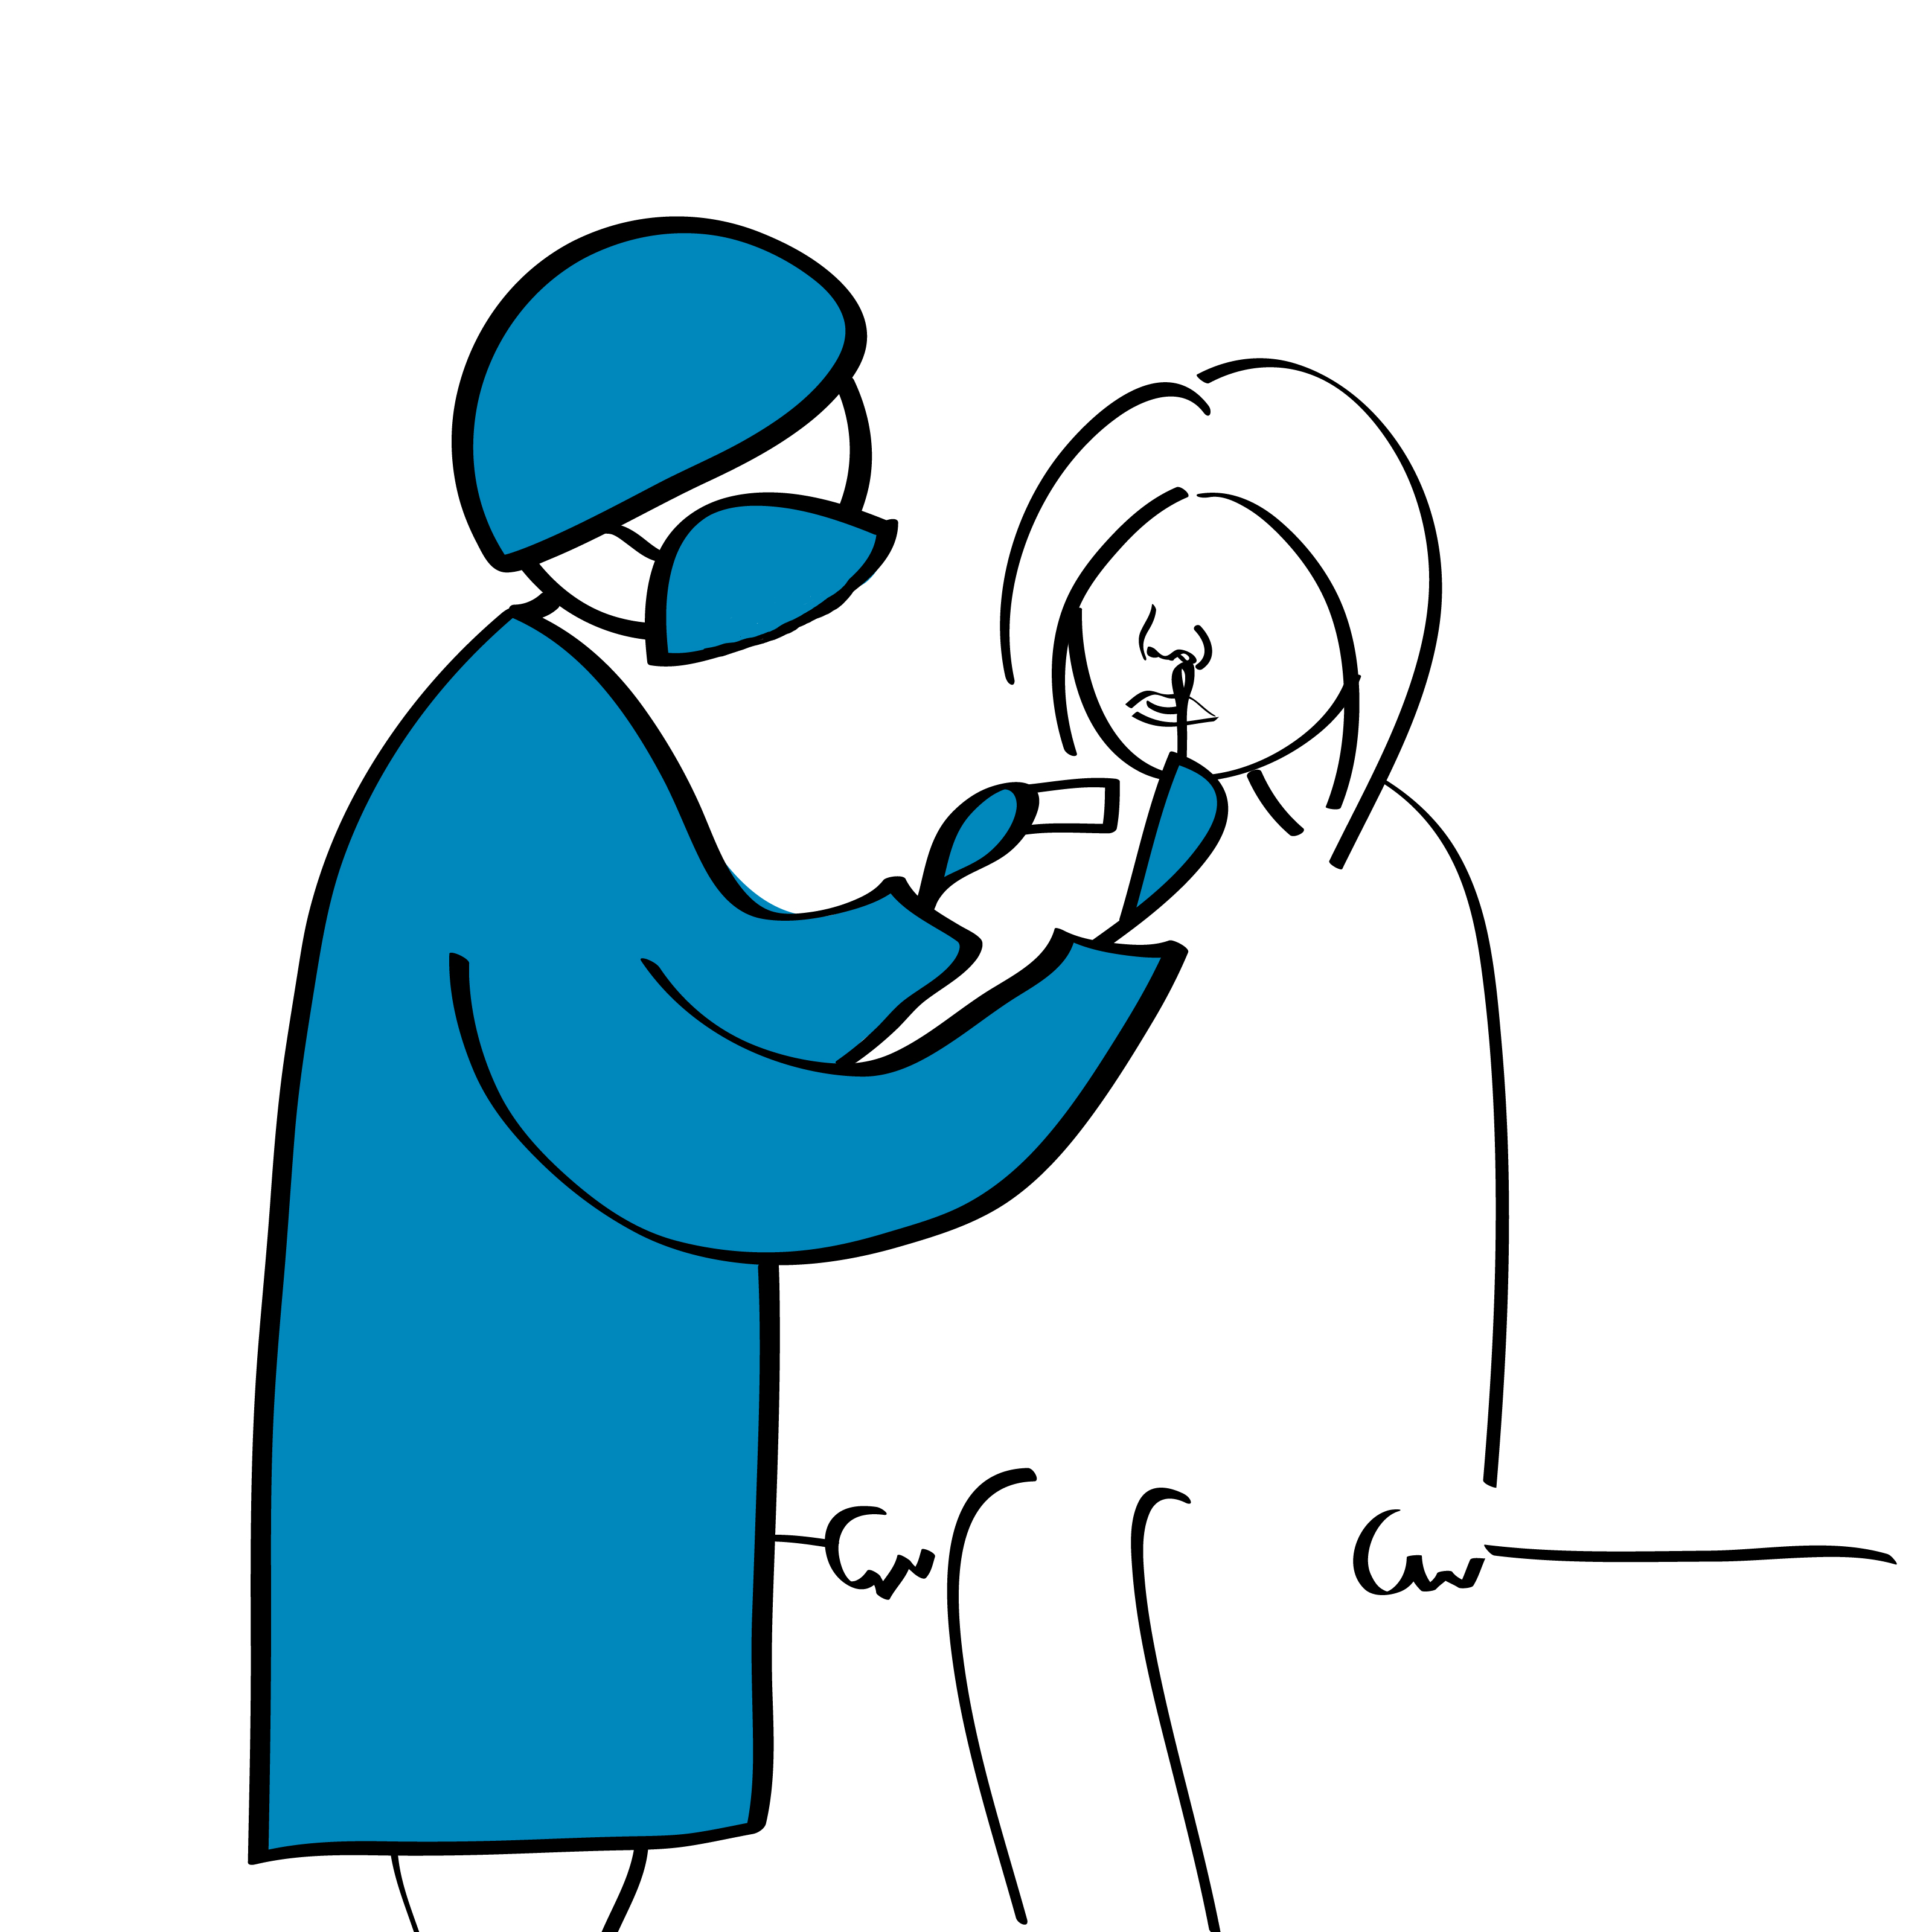
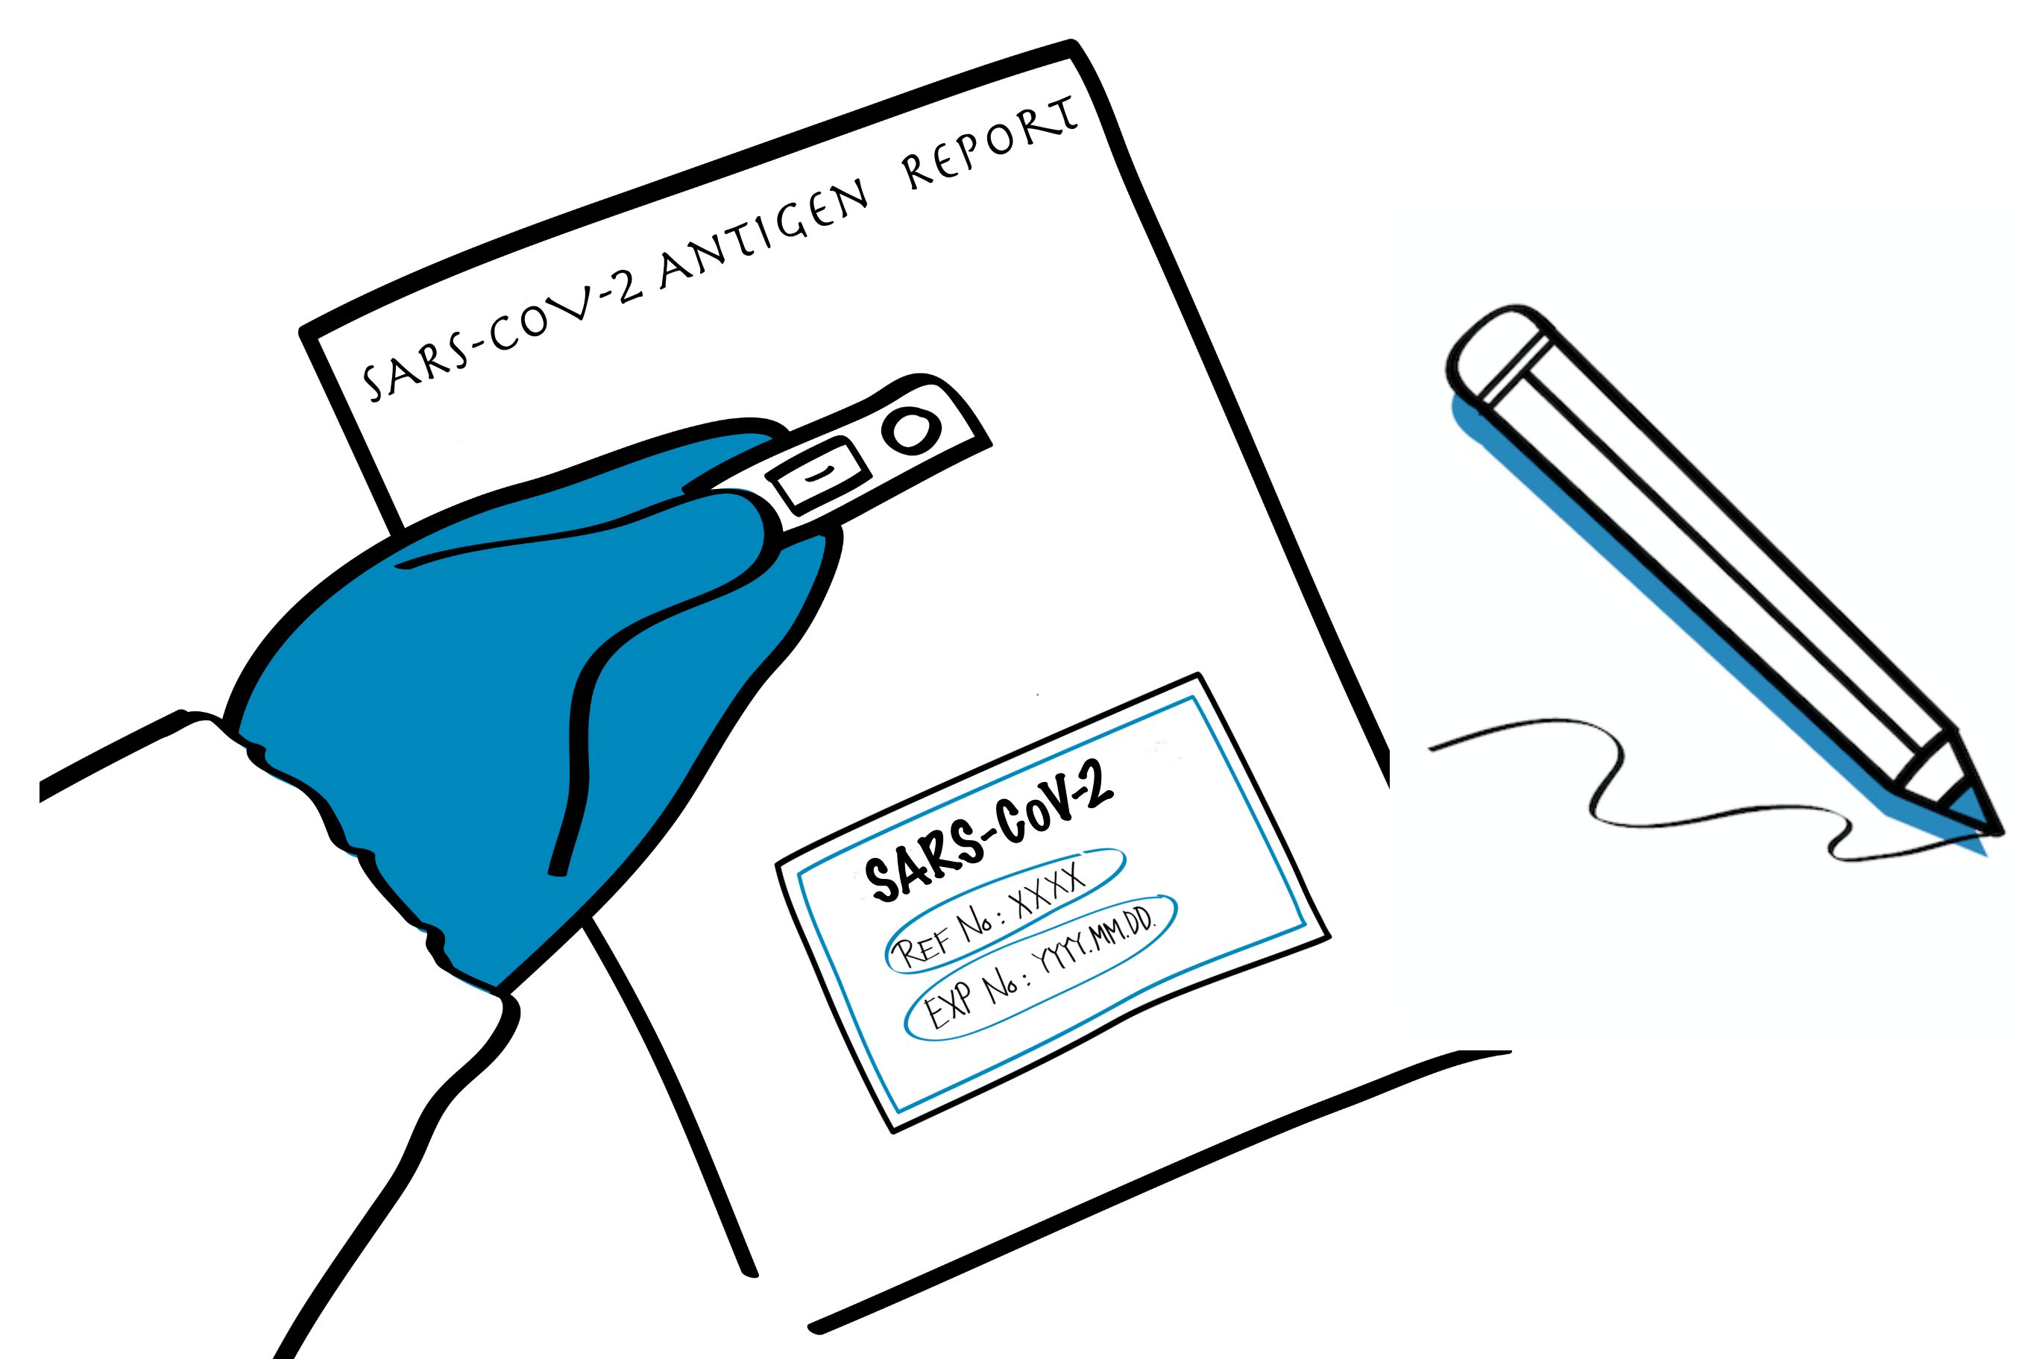
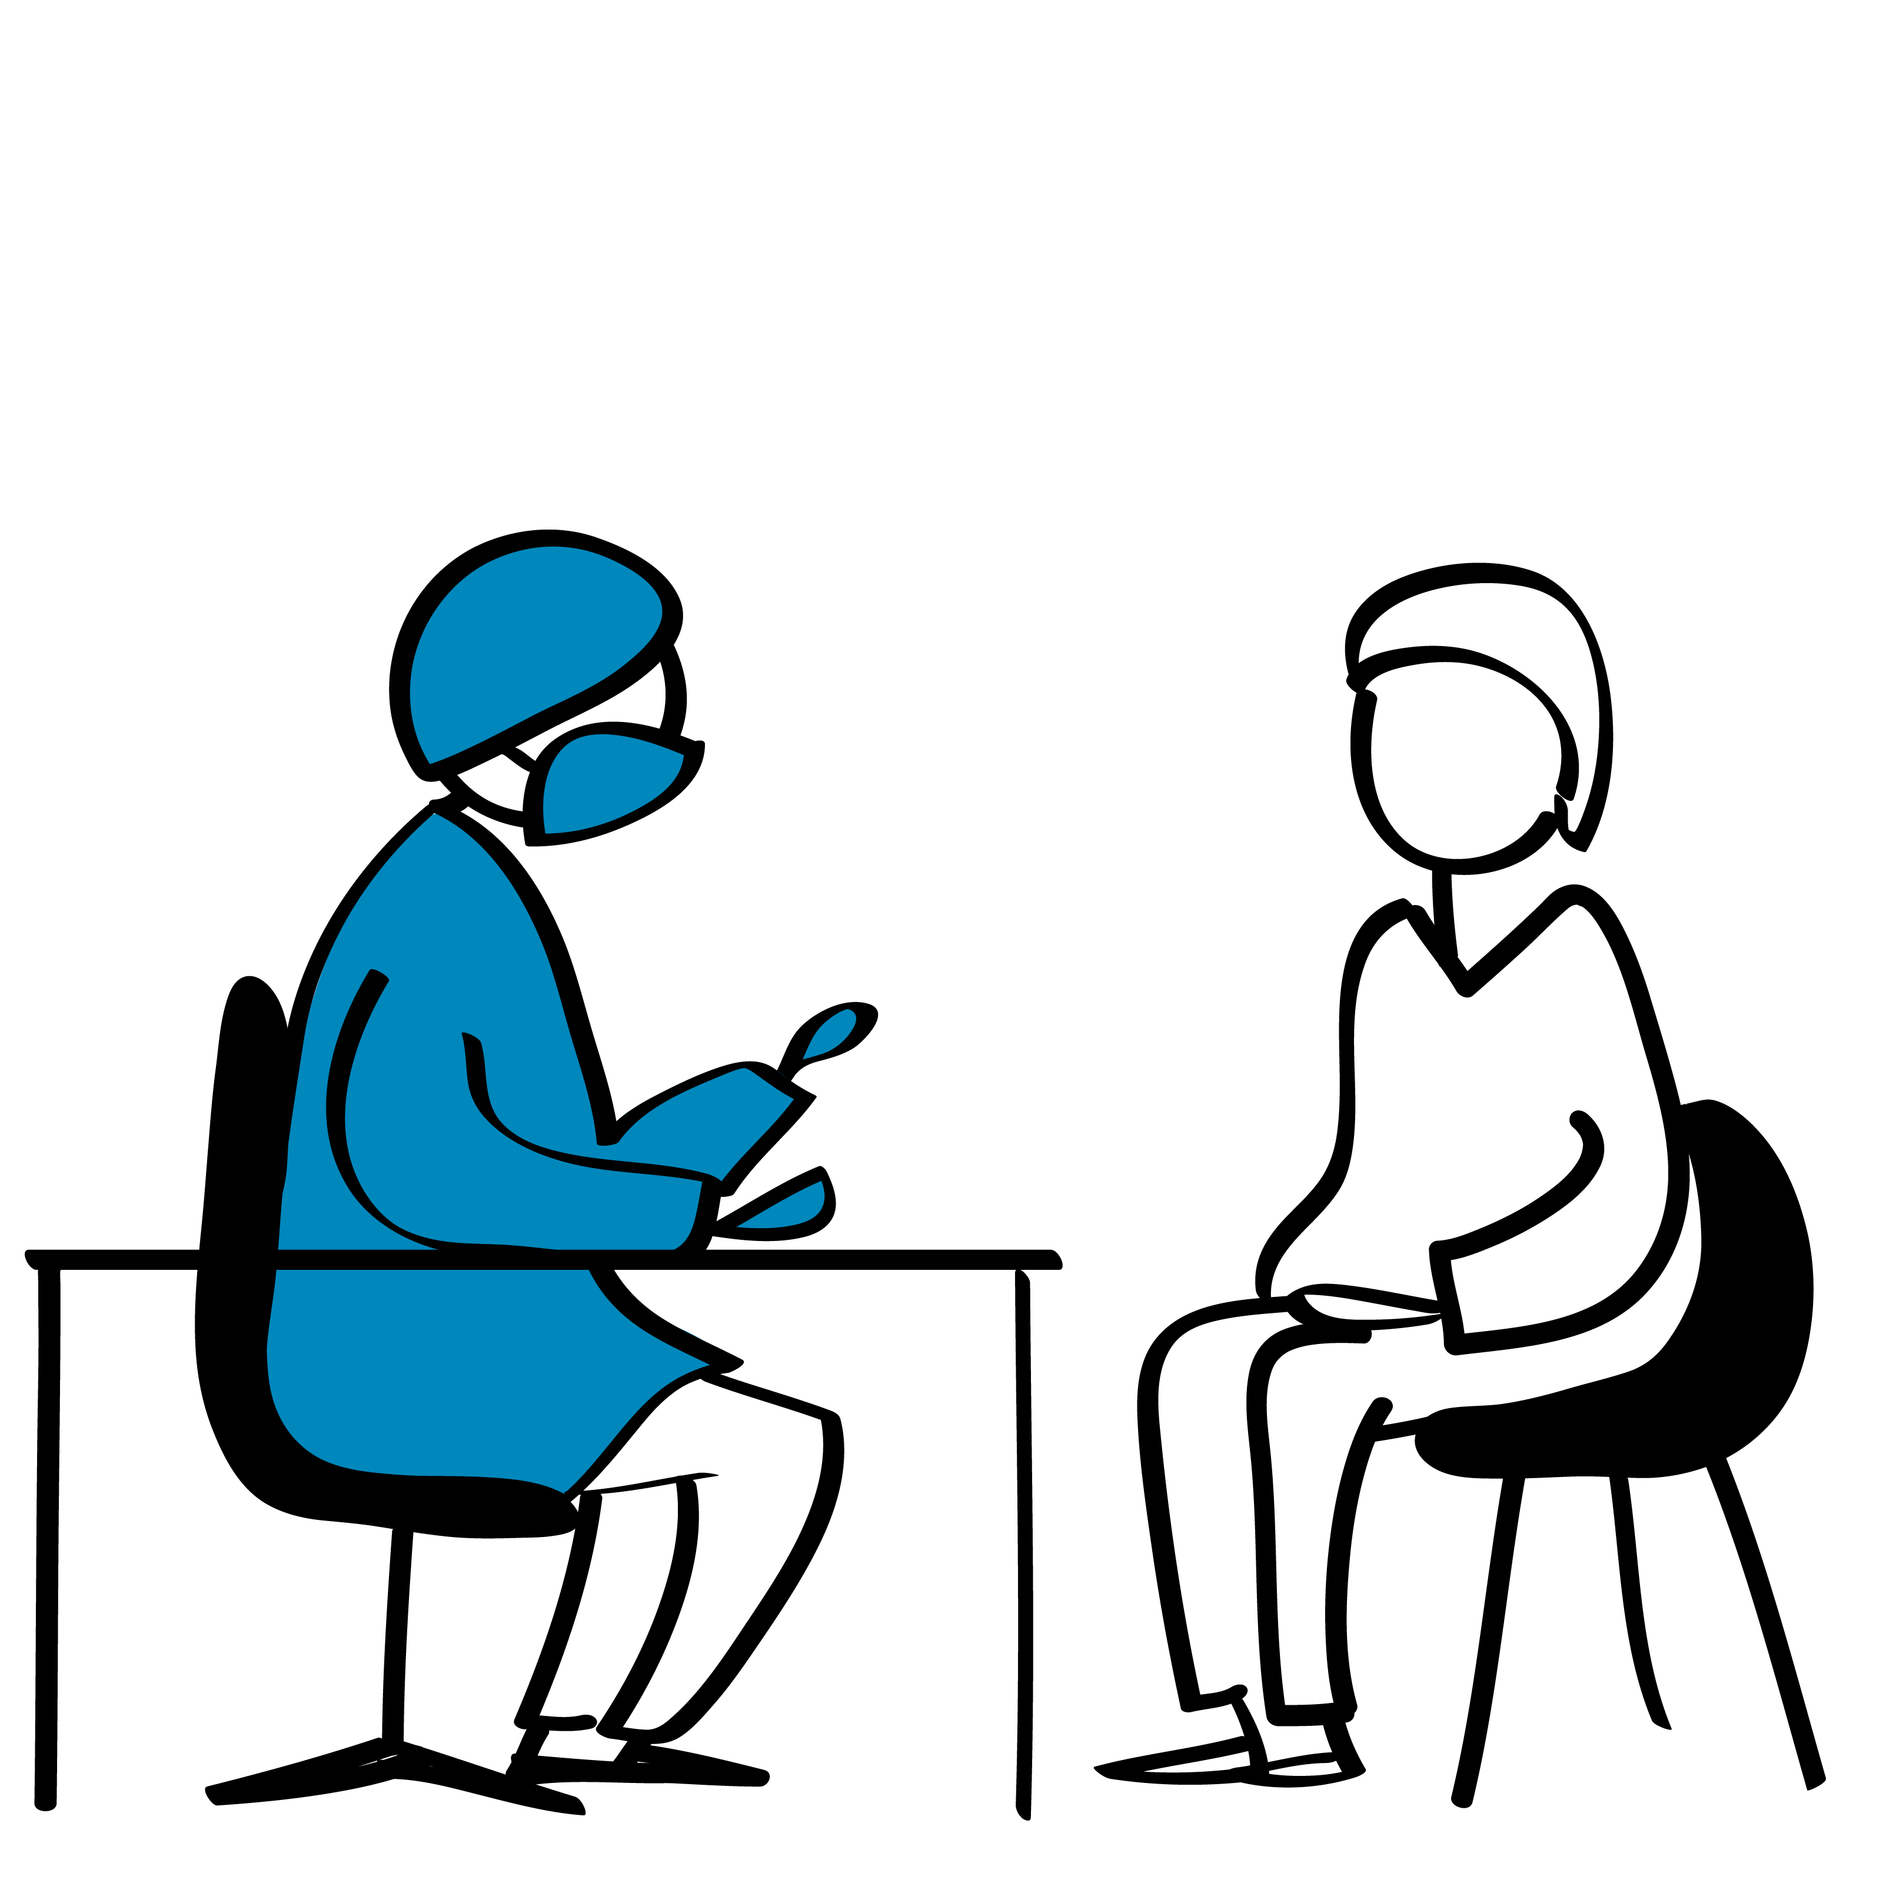
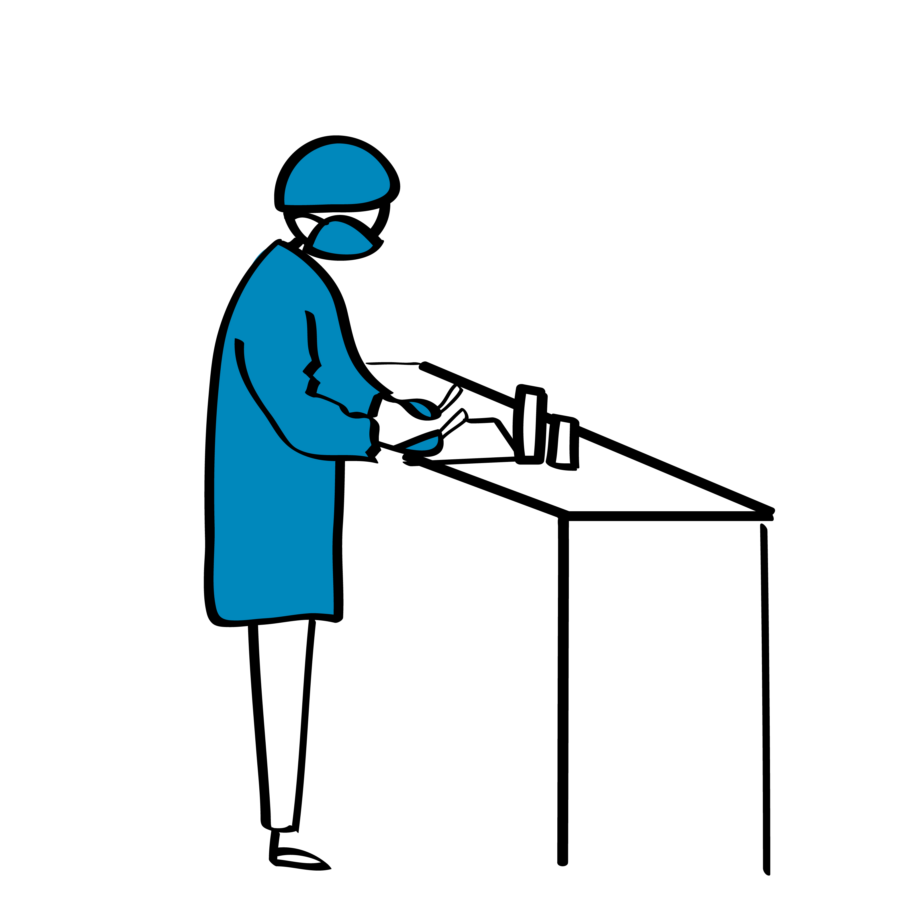
When do testing errors occur?
Before testing
Store test kits correctly
Select the right people for testing
Collect samples correctly
During testing
Test the right sample
Follow the correct test procedure
Perform quality control
After testing
Read and record the result correctly
Report the right result
At all stages of the testing process

Slide 6
Inaccurate results
Inaccurate results may result in:
a person without SARS-CoV-2 infection being classified as having COVID-19 (false positive)
or
a person with SARS-CoV-2 infection being classified as not having COVID-19 (false negative)
Invalid results require the collection of an additional sample. If the person does not return to the health facility, a possible COVID-19 diagnosis may be missed.

Slide 7
Consequences of inaccurate results
False-positive results incorrectly label an uninfected person as being infected with SARS-CoV-2. Consequences include unnecessary quarantine, stigma, psychological distress and unnecessary use of limited resources on contact tracing.
False-negative results mean that infected persons are not detected. Therefore, they may not be isolated and can infect others. In addition, patients with moderate or severe disease may not get appropriate care for COVID-19.

Slide 8
Why do inaccurate results occur?
Individual responsibilities are unclear.
There are no written procedures.
Written procedures are not followed.
Training is not done or not completed.
Checks are not done for transcription errors (results recorded incorrectly).
Test kits are not stored properly.
The inherent nature of the test itself (i.e. sensitivity and specificity).
Quality control (QC) measures are not performed.

Slide 9
Errors before testing and how to avoid them
Error | How to prevent or correct the error
Incorrect sample type collected | Refer to the procedure/job aid for sample types that can be tested using a SARS-CoV-2 Antigen RDT.
Sample mislabelled or unlabelled | Cross-check labelling of the sample container with the sample request form to ensure they are the same.
Sample stored or transported incorrectly before testing | Test the sample immediately after sample collection. Where samples have to be stored or transported from the collection to the testing site, follow the manufacturer’s instructions on maximum time and temperature of storage.
Test kits stored incorrectly | Follow the manufacturer’s instructions on storage conditions. Monitor the temperature of the storage room and testing site. Check expiry dates of kits and use kits with the earliest expiry date first. Do not use kits that are past their expiry date.

Slide 10
Errors during testing and how to avoid them
Error | How to prevent or correct the error
Test is incorrectly labelled | Cross-check labelling of the test with the sample request form to ensure they are the same.
Results reported when quality control results are invalid | Perform and review quality controls. Only report results if the tests have passed quality control.
Wrong volume of sample added | Follow the manufacturer’s instructions for the correct sample volume to be added.
Reagents stored incorrectly or used after expiry date | Follow the manufacturer’s instructions on storage conditions. Monitor the temperature of the storage room and testing site. Check expiry dates of kits and use kits with the earliest expiry date first. Do not use kits that are past their expiry date.

Slide 11
Errors after testing and how to avoid them
Error | How to prevent or correct the error
Result reported on the wrong patient | Cross-check labelling of the sample container with the sample request form, test and identifier on the report to ensure they are the same.
Report illegible | Write clearly on the report so it can be understood by others.
Report sent to the wrong location | Check that the location on the sample request form is the same as on the report.

Slide 12
Key points
Errors can occur at all stage of the testing process.
Inaccurate results may result in:
a person without SARS-CoV-2 infection being classified as having COVID-19 (false positive)
or
a person with SARS-CoV-2 infection being classified as not having COVID-19 (false negative).
It is your responsibility to ensure the quality of the tests you perform by avoiding errors in testing.

Slide 13
Questions?

