Slide 1
03
SARS-CoV-2 testing strategies

Slide 2
Disclaimer
WHO Health Security Learning Platform – Training Materials
These WHO Training Materials are © World Health Organization (WHO) 2020. All rights reserved.
Your use of these materials is subject to the “WHO Health Security Learning Platform, Training Materials – Terms of Use”, which you accepted when downloading them and which are available on the Health Security Learning Platform at: https://extranet.who.int/hslp.
Should you adapt, modify, translate, or in any other way revise the contents of these materials, you shall not imply that WHO is in any way affiliated with such modifications and shall not use the WHO name or emblem in such modified materials.
Furthermore, please inform WHO of any modifications of these materials that you use publicly, for record-keeping purposes and continued development, by emailing ihrhrt@who.int.

Slide 3
Learning objectives
At the end of this module, you should be able to:
explain the key recommendations for the use of SARS-CoV-2 Antigen RDTs
describe scenarios in which SARS-CoV-2 Antigen RDTs should be used
describe scenarios in which SARS-CoV-2 Antigen RDTs should not be used.

Slide 4
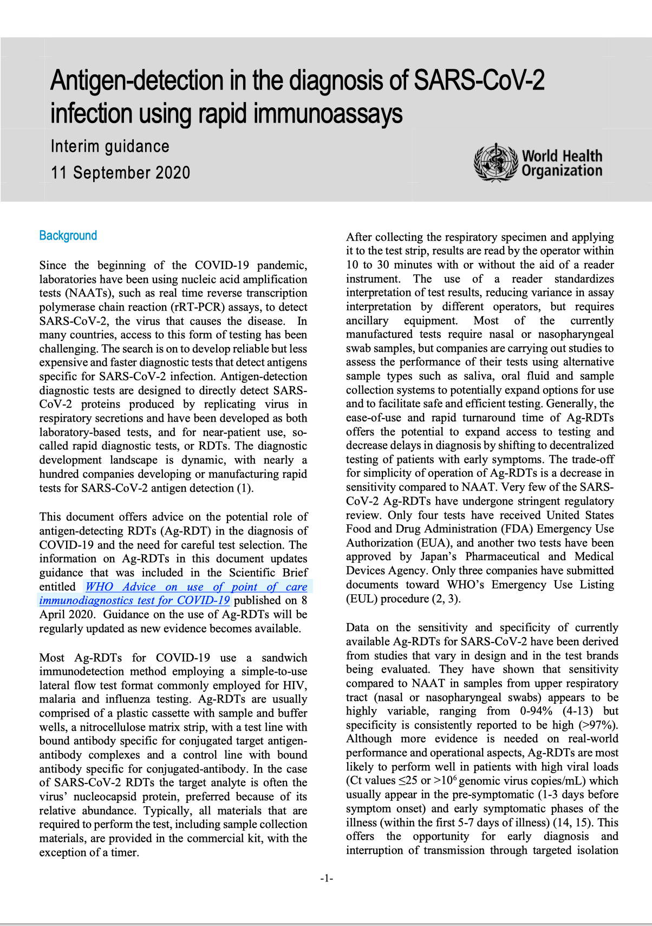
Global guidance
WHO has released interim guidance on the use of SARS-CoV-2 Antigen RDTs:
Antigen-detection in the diagnosis of SARS-CoV-2 infection using rapid immunoassays. Interim guidance – 11 September. Geneva: World Health Organization; 2020 (https://apps.who.int/iris/handle/10665/334253)

Slide 5
Who can be detected by SARS-CoV-2 Antigen RDTs?
Viral load
Most contagious individuals
Ag-RDT detection cut-off
Viral culture cut-off
PCR detection cut-off
-2
0
2
4
6
20
Time (days)
Symptoms onset

Slide 6
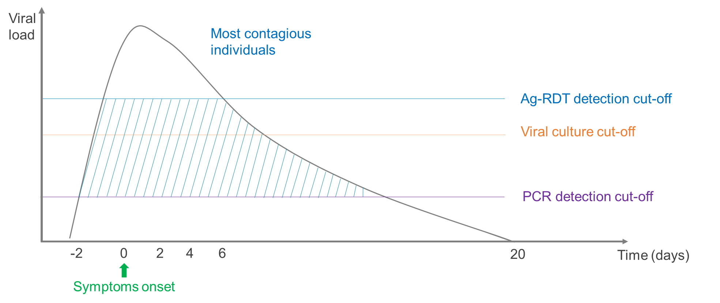
Recommendations (1)
SARS-CoV-2 Antigen RDTs must meet the minimum performance requirements¹ of ≥80% sensitivity² and ≥97% specificity³ compared to an approved NAAT (nucleic acid amplification test) molecular test.
As SARS-CoV-2 Antigen RDTs are easy to perform and give a rapid result, they can help expand testing and decrease delays in diagnosis by shifting testing from the reference laboratory to the clinical facility.
The trade-off for simplicity is a decrease in sensitivity compared to NAAT molecular tests.
These cases could be missed if only a SARS-CoV-2 Antigen RDT is performed.
¹ Antigen-detection in the diagnosis of SARS-CoV-2 infection using rapid immunoassays. Interim guidance – 11 September 2020. Geneva: World Health Organization; 2020.
² Sensitivity refers to the percentage of SARS-CoV-2 infected patients who are correctly identified as having SARS-CoV-2 infection.
³ Specificity refers to the percentage of non-infected people who are correctly identified as not having SARS-CoV-2 infection

Slide 7
Recommendations (2)
SARS-CoV-2 Antigen RDT testing can be considered if there is widespread community transmission of COVID-19, the health system is over-burdened, and it is not possible to test all suspected cases by molecular testing methods.¹
SARS-CoV-2 Antigen RDT testing should be conducted by trained operators in strict accordance with the manufacturer’s instructions early in the disease (typically 1−3 days prior to the onset of symptoms and during the first 5−7 days after the onset of symptoms) when viral loads are highest.^{1, 2}
¹ Antigen-detection in the diagnosis of SARS-CoV-2 infection using rapid immunoassays. Interim guidance – 11 September 2020. Geneva: World Health Organization; 2020
² SARS-CoV-2 antigen-detecting rapid diagnostic tests: An Implementation Guide- 21 December 2020. Geneva: World Health Organization; 2020

Slide 8
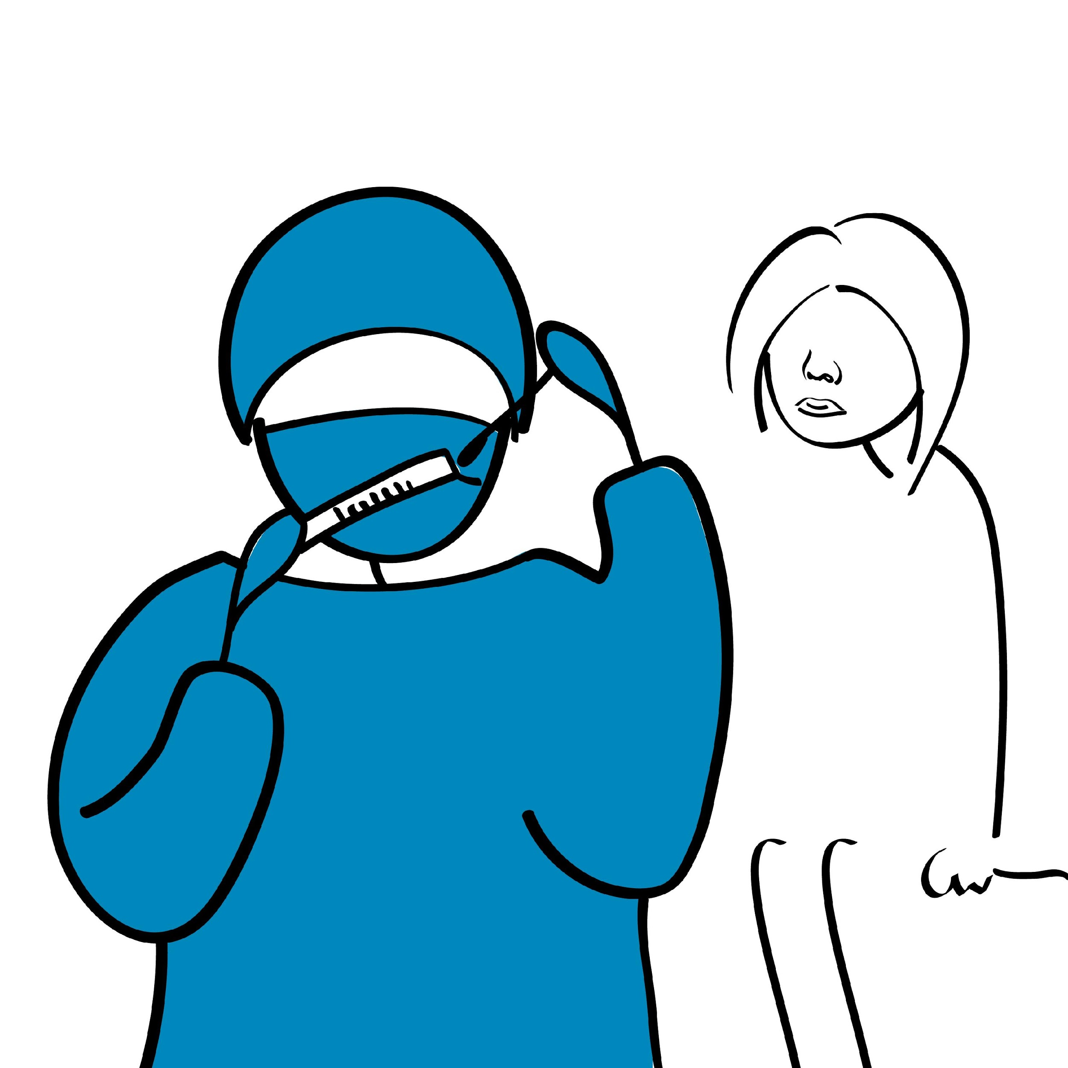
Recommendations (3)
For initial introduction of SARS-CoV-2 Antigen RDTs into clinical use, consider selecting some settings where molecular confirmatory testing is available in order to:¹
Give staff confidence in the SARS-CoV-2 Antigen RDTs
Confirm performance of the SARS-CoV-2 Antigen RDTs
Troubleshoot any implementation issues
¹ Antigen-detection in the diagnosis of SARS-CoV-2 infection using rapid immunoassays. Interim guidance – 11 September 2020. Geneva: World Health Organization; 2020.

Slide 9
When to use SARS-CoV-2 Antigen RDTs¹
To respond to suspected outbreaks in institutions or semi-closed communities where NAAT molecular testing is not available
To support outbreak investigations (e.g., schools, long-term care or nursing care homes, workplaces, etc.)
To monitor trends in COVID-19 rates in communities and among essential workers and health workers
To detect positive cases in health facilities and in communities with widespread transmission
To test asymptomatic contacts of cases, even if SARS-CoV-2 Antigen RDTs are not specifically authorized for this use because the viral loads are expected to be comparable in people who have not yet developed symptoms.
¹ Antigen-detection in the diagnosis of SARS-CoV-2 infection using rapid immunoassays. Interim guidance – 11 September 2020. Geneva: World Health Organization; 2020.

Slide 10
Repeat and confirmatory testing¹
If there is uncertainty around the SARS-CoV-2 Antigen RDT result (e.g., the adequacy of sampling), the test should be repeated on a fresh sample.
A negative SARS-CoV-2 Antigen RDT result cannot completely rule out an active COVID-19 infection.
Repeat testing with a SARS-CoV-2 Antigen RDT within 48 hours (or preferably confirmatory testing using an NAAT molecular test) should be performed whenever possible and particularly in symptomatic patients.
Wherever molecular testing is used for confirmatory testing in patients screened using SARS-CoV-2 Antigen RDTs, the samples for the two tests should be collected at roughly the same time or at least within two days of each other.
¹ Antigen-detection in the diagnosis of SARS-CoV-2 infection using rapid immunoassays. Interim guidance – 11 September 2020. Geneva: World Health Organization; 2020
² SARS-CoV-2 antigen-detecting rapid diagnostic tests: An Implementation Guide- 21 December 2020. Geneva: World Health Organization; 2020

Slide 11
When NOT to use SARS-CoV-2 Antigen RDTs^{1,2}
Based on current knowledge, do not use SARS-CoV-2 Antigen RDTs if COVID-19 is unlikely, such as:
In individuals without symptoms, unless the person is a contact of a confirmed case (because positive results are more likely to be false positive results and confirmatory testing must be readily available to confirm these cases)
Where there are zero or only few cases (because positive test results are more likely to be false positive results)
Where appropriate biosafety and infection prevention and control measures are lacking (because health care workers collecting the samples will be in danger of being infected)
¹ Antigen-detection in the diagnosis of SARS-CoV-2 infection using rapid immunoassays. Interim guidance – 11 September 2020. Geneva: World Health Organization; 2020.
² These recommendations are based on current scientific evidence. As new evidence emerges, these recommendations may evolve.

Slide 12
When NOT to use SARS-CoV-2 Antigen RDTs^{1,2}
Where management of the patient would not change based on the result of the test (because there would be no benefit to the patient irrespective of the result)
For airport or border screening at points of entry (because the likelihood of a positive result is low)
In screening prior to blood donation (because a positive SARS-CoV-2 Antigen RDT result does not mean that the virus is in the blood)
¹ Antigen-detection in the diagnosis of SARS-CoV-2 infection using rapid immunoassays. Interim guidance – 11 September 2020. Geneva: World Health Organization; 2020.
² These recommendations are based on current scientific evidence. As new evidence emerges, these recommendations may evolve.

Slide 13
Country algorithm
Adapt according to the guidelines in your country
Insert the country algorithm for SARS-CoV-2 Antigen RDT here

Slide 14
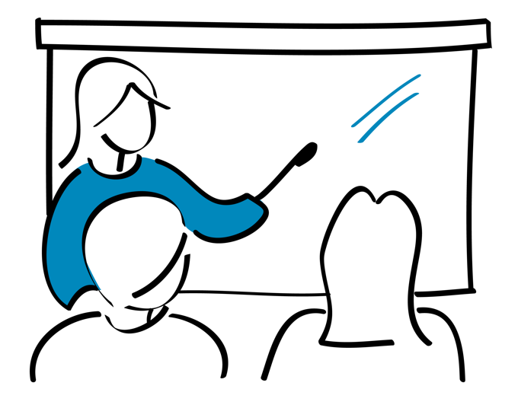
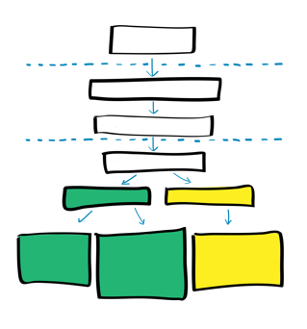
Key points
SARS-CoV-2 RDTs should meet minimum performance criteria of ≥80% sensitivity and ≥97% specificity compared to an approved NAAT.
The trade-off for simplicity of use of Ag-RDTs is a decrease in sensitivity compared to NAAT molecular tests.
Because of this lower sensitivity, WHO recommends for these tests to be used in five scenarios.

Slide 15
Questions?

